Slide 1

Skin Cancer Classification with Mobile Net
Faculty of computer science and information
Selected topics in computer science–2 (cs_396)

Slide 2
Team #4
Member | ID
دنيا سيد محمد محمدي | 202000297
احمد مصطفي محمد زين الدين | 202000088
أحمد محي عبد الحي بيومي | 202000085
تسنيم حاتم وفيق العدوي | 202000222
حورية محمود عبد العليم | 202000282
عمر عماد الدين محمد | 202000604

Slide 3
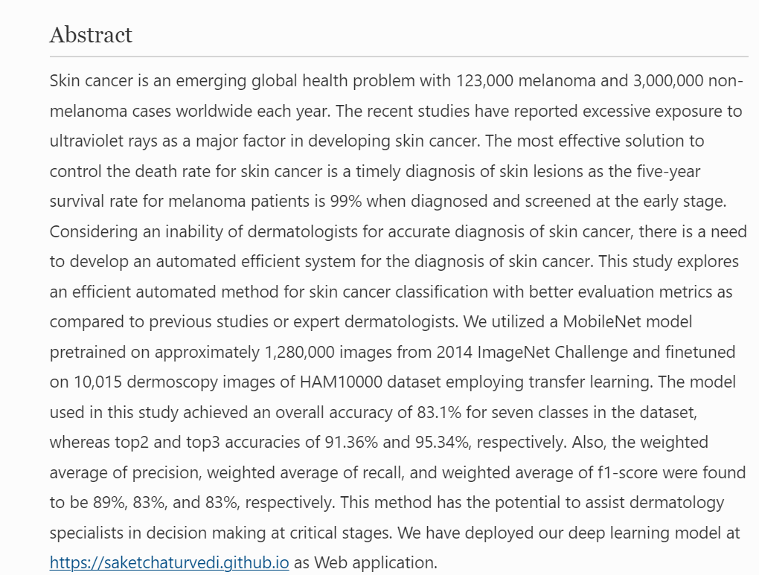
introduction
Brief overview of the paper:
paper gave a brief look at skin cancer and how it is widespread in the world and the reasons for its spread and it is necessary to detect skin cancer early so a way was invented to detect the disease so the mobile net model was used

Slide 4

Mobile NET Model
The purpose of the model is to assist dermatologists and other medical professionals in diagnosing skin cancer more accurately and efficiently, by providing an automated classification tool that can analyze images of skin lesions and provide a diagnosis.
the Mobile Net model can provide a more objective and accurate diagnosis, which can help improve patient outcomes and reduce unnecessary biopsies and surgeries.
One key feature of the Mobile Net model is its use of transfer learning, which allows the model to leverage pre-trained weights from other deep learning models to improve its performance
overall, skin cancer classification with Mobile Net is a promising approach to improving the accuracy and efficiency of skin cancer diagnosis, and has the potential to improve patient outcomes and reduce healthcare costs

Slide 5
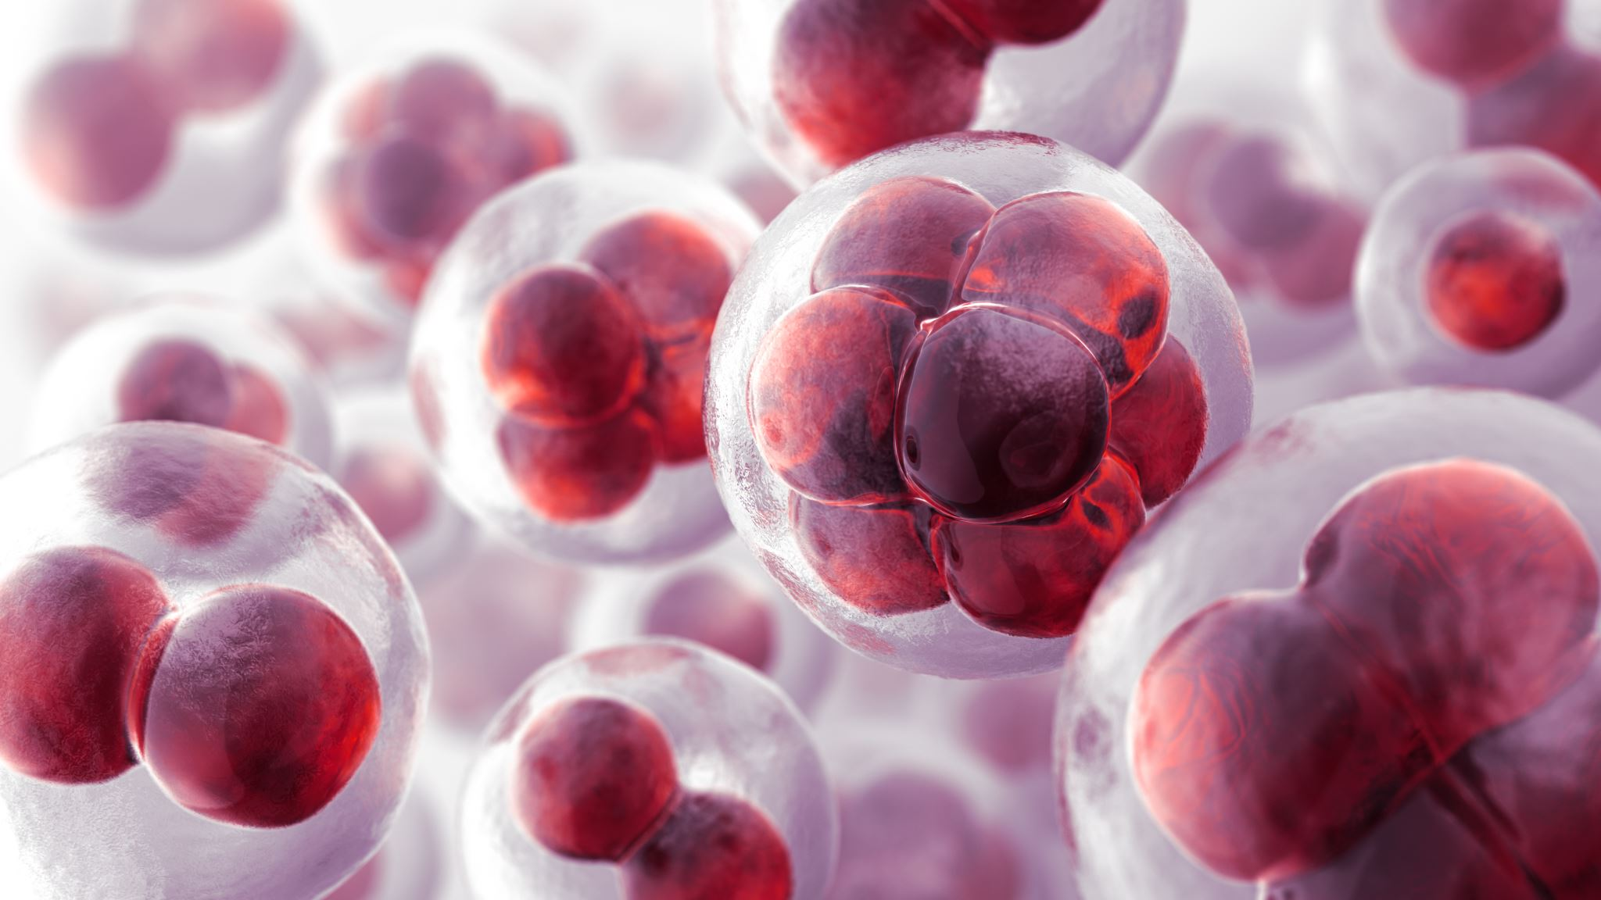
MODEL
Intro About Datasets: this set consists of 2357 images of malignant and benign oncological diseases , All images were sorted according to the classification taken with ISIC, and all subsets were divided into the same number of images, with the exception of melanomas and moles.
The data set contains the following diseases:
actinic keratosis
basal cell carcinoma
dermatofibroma
melanoma
nevus
pigmented benign keratosis9
seborrheic keratosis
squamous cell carcinoma
vascular lesion

Slide 6
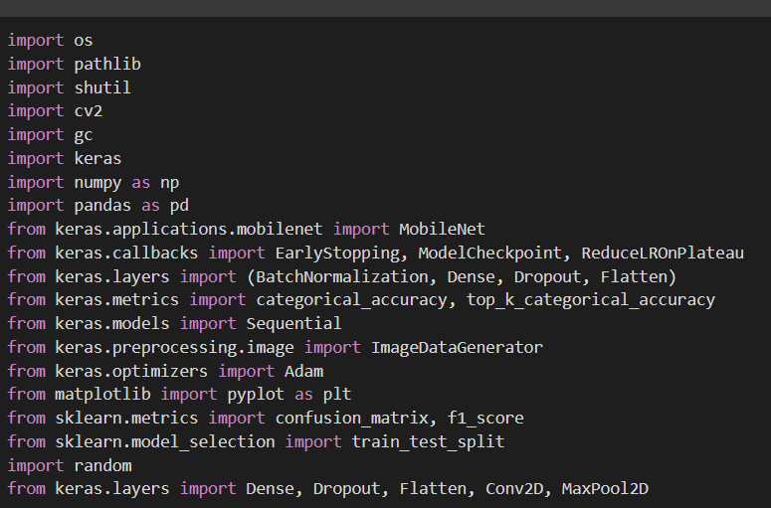
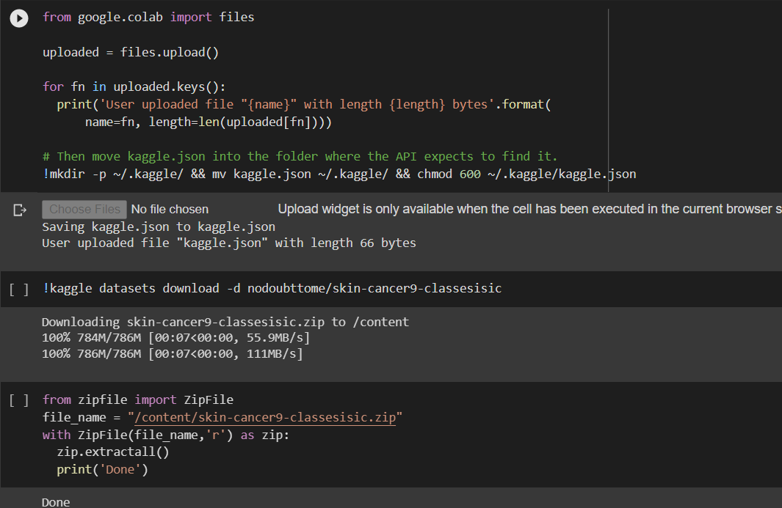
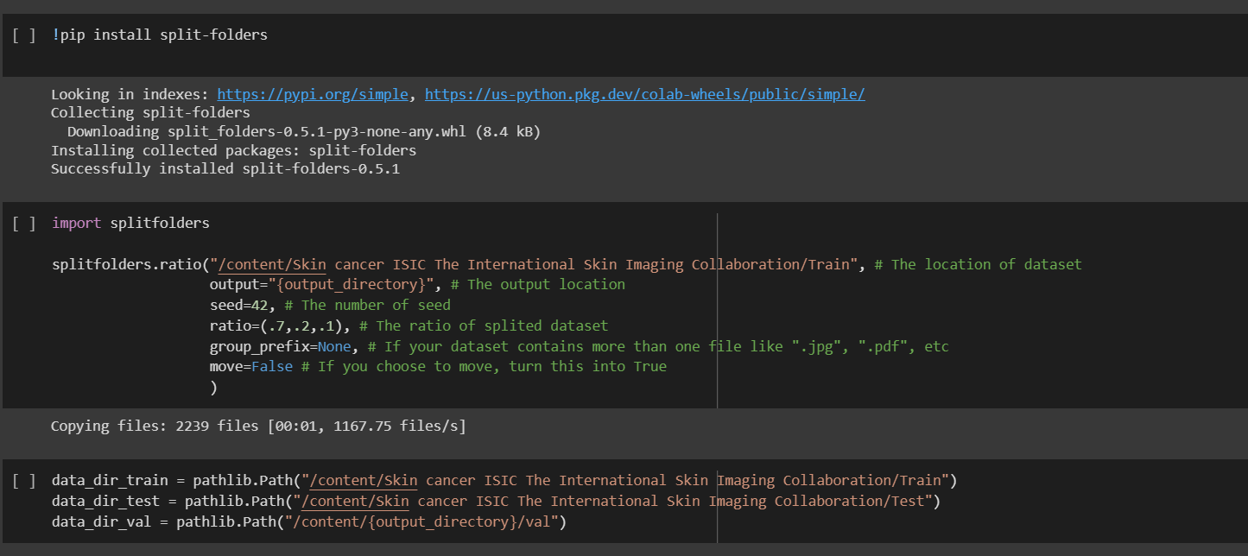
Preparing Dataset on google colab

Slide 7
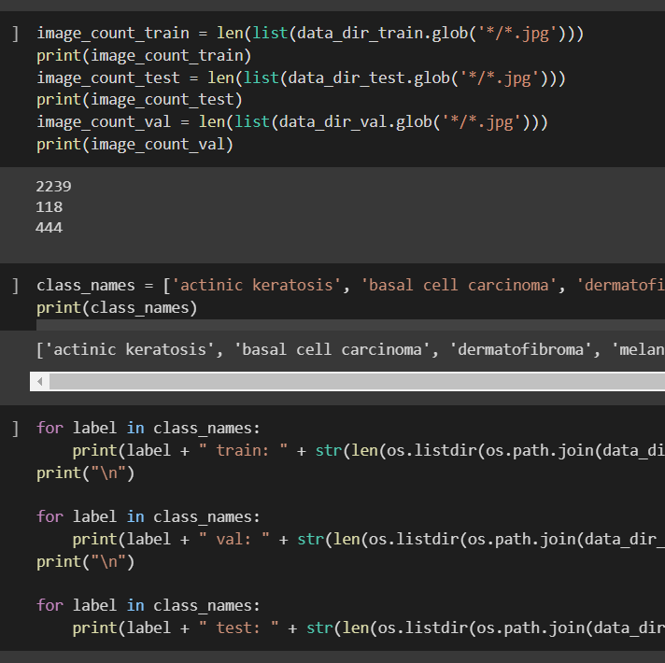
Date Preprocessing
Declare the Train Test and Validation
define the Class Names (Labels)
Calculates the number of images per Labels for our data set

Slide 8
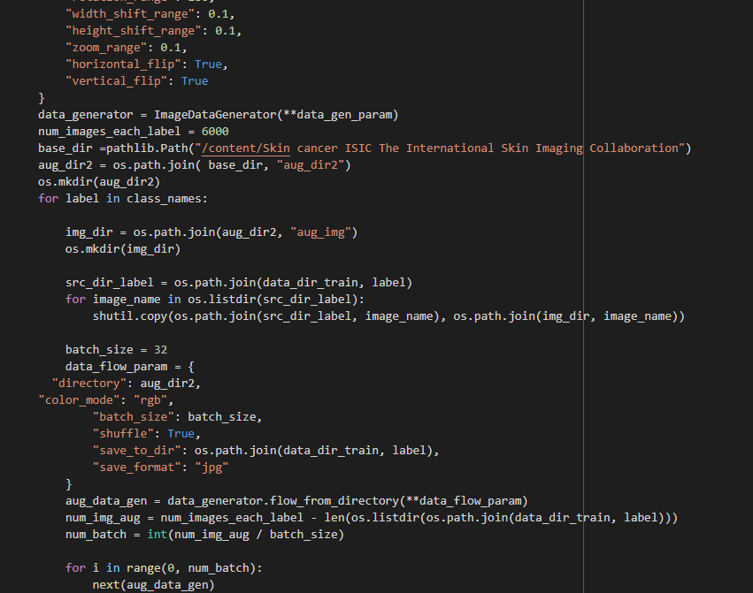
Data Augmentation
in this part we will talk about the most important part of avoid the overfit in the mode by Augmentation to our Data set we will balance the labels at our model to be more suitable for the best results that we will generate
we used Image Data Generator

Slide 9
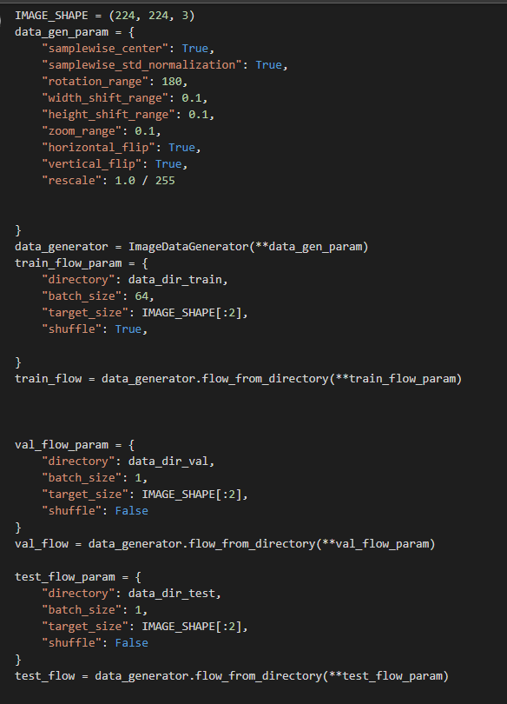
ImageDataGenerator
This code initializes ImageDataGenerator objects for data augmentation and creates generator objects for the training, validation, and test datasets using these ImageDataGenerator objects.

Slide 10
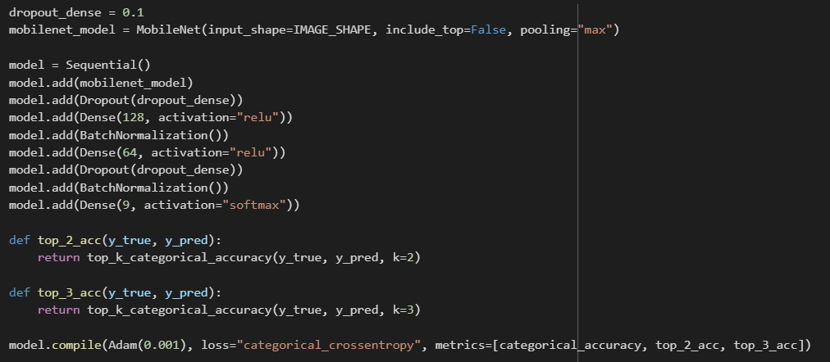
Building Architecture and Training Algorithm
This heart of our model that we want to build our model based on Transfer Learning
We used Mobile net in our mode with Base Model that contain about 3,228,864
and Trainable params: 3,206,976 , Non-trainable params: 21,888
and we have a some of details about the architecture

Slide 11
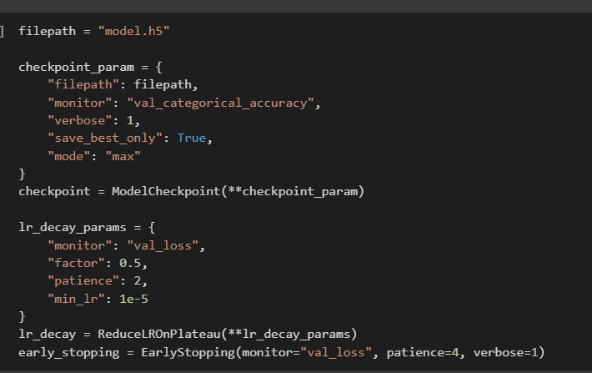
Tune Hyperparameter
This is the most important part for our model in the case of learning weights , saving it
And improve the performance of the model

Slide 12
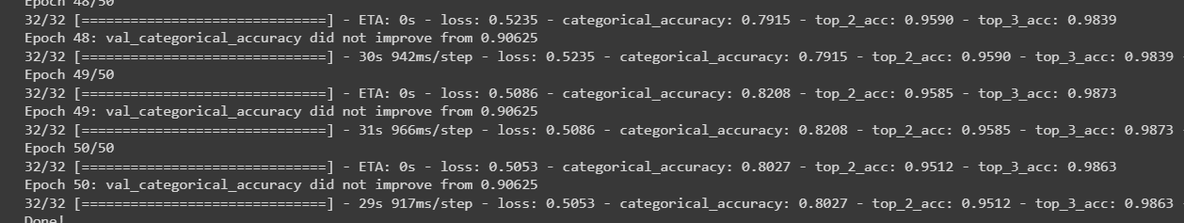
Model Fit
This is the part of fitting the model with train and validation data
The model achieved top2 and top3 accuracies of 95% and 98%

Slide 13
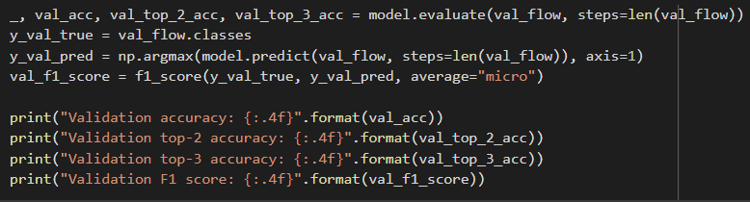
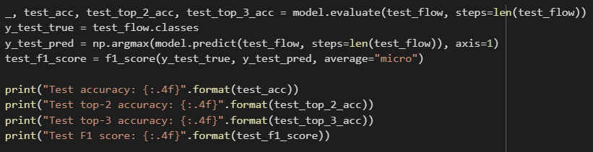
Model Evaluation
As a result for the following epochs the accuracy of the model :
Validation
Testing

Slide 14
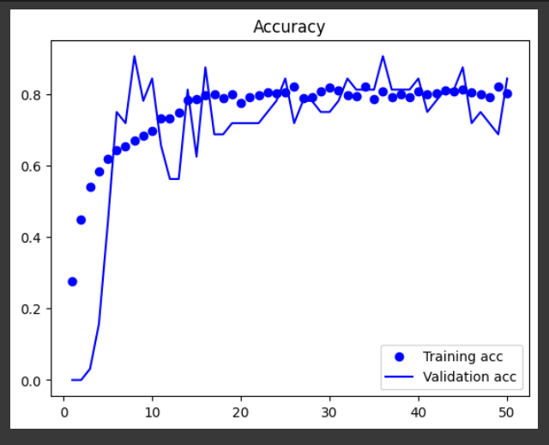
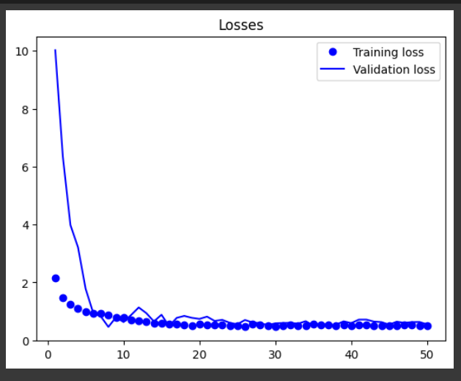
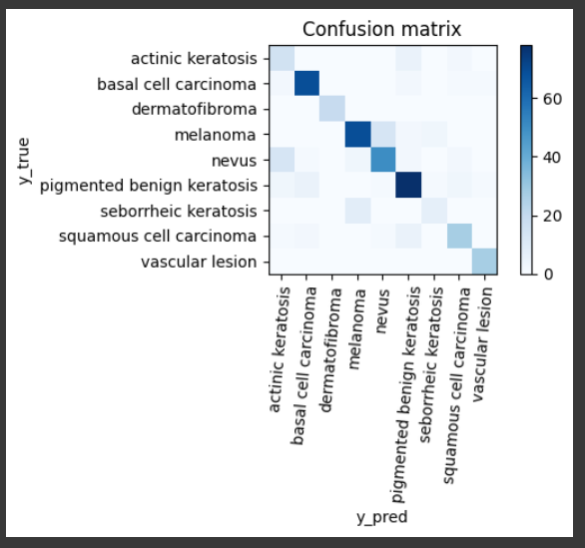
Charts of Losses , Accuracy ,Confusion Matrix

Slide 15

THANK YOU

